Slide 1
Making this resource work for you
Prior to teaching this lesson, please refer to the ‘Unit Overview and Planning Document’.
Further guidance on planning Science Mastery lessons can be found in the detailed planning guidance document.
Refer to the ‘notes’ section on each slide for useful information, including suggested expositions, pedagogical content knowledge, suggested questions, answers and more. Consider using presenter mode so you can see this guidance throughout the lesson.
The introduction slides can be adapted to suit your teaching style and the needs of your class.
Before the lesson, adapt the fix-it slide to address any misconceptions identified in the previous lesson’s exit ticket.
Choose from the suggested activities to suit your class. The intention is not that you complete all of these, but that you select those which ones are most appropriate for your students. It may be appropriate to further adapt activities for your students.
These lessons are designed to occupy approximately 1 hour. To adapt for a shorter or longer lesson duration we advise you to adapt the activity section accordingly.
Please consider using the final slide to send feedback about this lesson or examples of PowerPoints that you have adapted to our design team. Your feedback is used to improve Science Mastery for all of our teachers and students. We appreciate all suggestions and comments.
Thank you for reading!
The Science Mastery Team

Slide 2
Feedback Lesson
Do Now:
Define density.
State the equation to calculate density.
Identify the state of matter with the highest density.
Identify the state of matter in which the forces between particles are the strongest.
Name a piece of equipment used to measure volume.
The mass per unit volume.
Density = mass/volume
Solid
Solid
Measuring cylinder, beaker, pipette

Slide 3
Feedback Lesson
Do Now:
Define density.
State the equation to calculate density.
Identify the state of matter with the highest density.
Identify the state of matter in which the forces between particles are the strongest.
Name a piece of equipment used to measure volume.
Drill:
Put the states of matter in order of increasing internal energy.
Identify the state(s) of matter that can be compressed.
Identify the state(s) of matter that have a fixed volume.

Slide 4
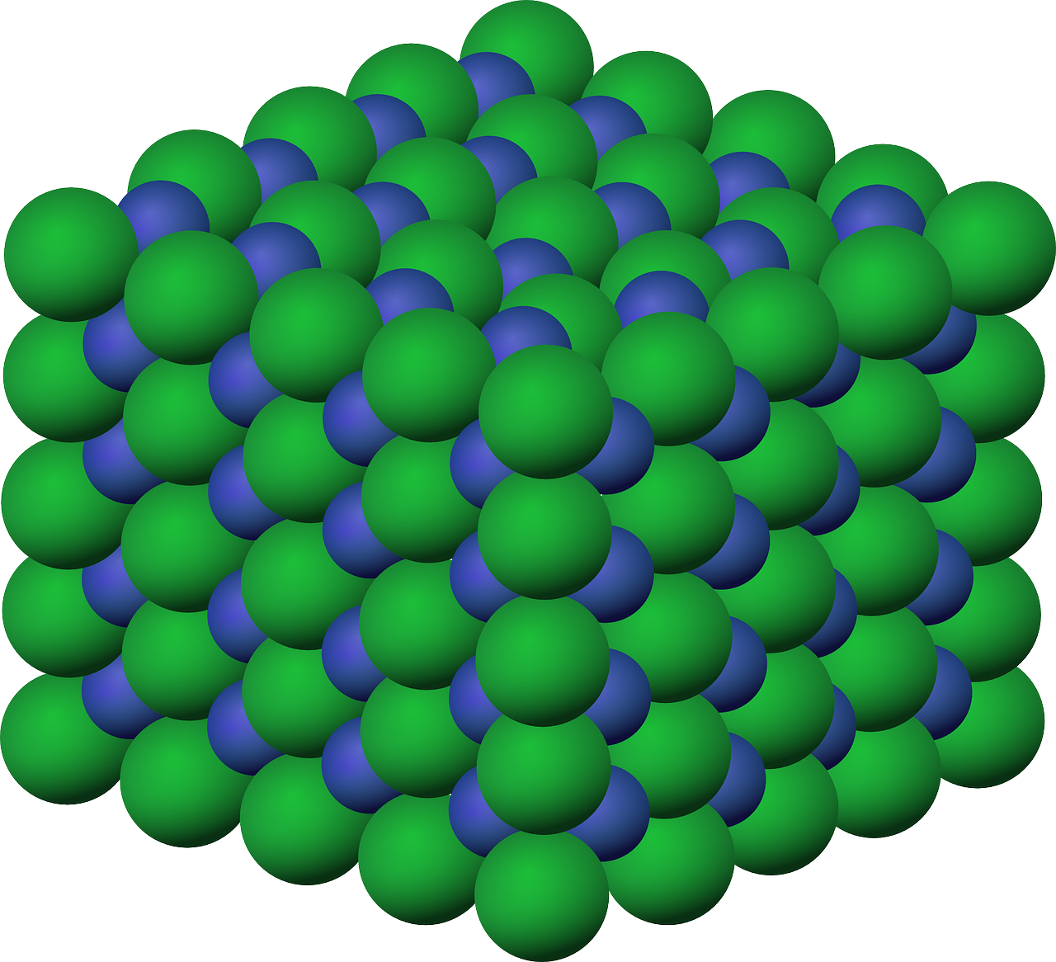
P4.1.7
27/06/2023
Feedback Lesson
P4.2.1 Prior Knowledge Review
P4.2.2 Density
P4.2.3 Measuring Density
P4.2.4 Gas Pressure
P4.2.5 Taking it Further: Pressure
P4.2.6 Taking it Further: Pressure in Fluids
P4.2.7 Feedback Lesson
Notes:
Big Idea: Energy is Conserved.

Slide 5

Following this lesson, students will be able to:
State…
Describe…
Explain…
Key Words:
matter
density
volume
density
mass
pressure
Notes:
Teacher to edit based on outcomes of mastery quiz

Slide 6
This is the fix-it portion of the lesson
The fix-it is an opportunity to respond to gaps in knowledge, especially those identified by the previous lesson’s exit ticket.
The teacher should customise this slide as needed, to facilitate
reteach, explanation, demonstration or modelling of ideas and concepts that students have not yet grasped or have misunderstood.
practise answering specific questions or of key skills.
redrafting or improving previous work.
Notes:
Proposal: Fix-it slide to spend time on any gaps identified in previous learning from mastery quiz.

Slide 7
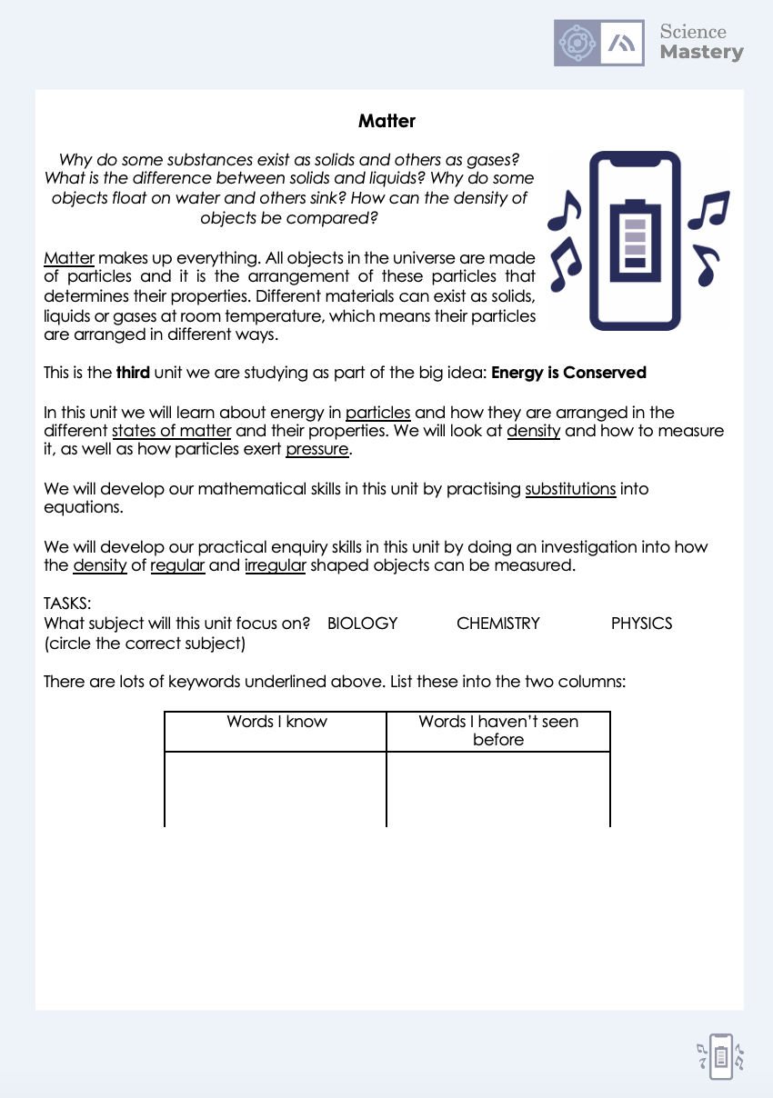
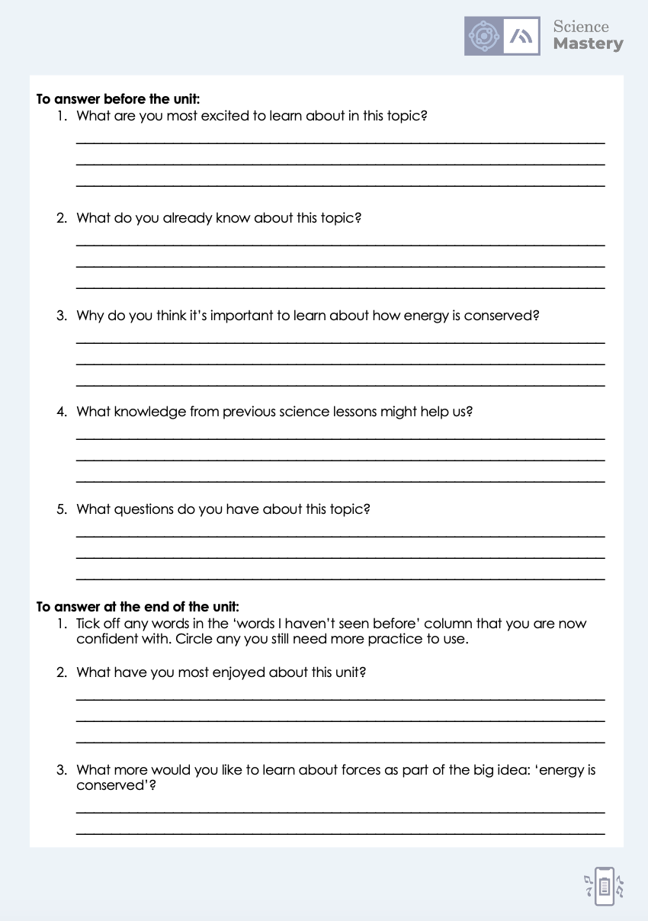
The Big Idea: Energy is Conserved
Notes:
Purpose:. The purpose of this resource is to provide students with an overview at the beginning and end of each unit. It is designed to create a discussion about the unit prior to and at the end of the sequence of lessons.
Teacher guidance:
Pupils should be directed to the P4.1 Link to Big Ideas worksheet (either in their booklet or printed). This may be back at the beginning of the sequence of lessons.
Teachers should use guided reading techniques to read aloud with the pupils and then pupils should answer the reflection questions. This could be used to summarise what pupils have learnt.
Questions on the student sheet:
1. Tick off any words in the ‘words I haven’t seen before’ column that you are now confident with. Circle any you still need more practice to use.
2. What have you most enjoyed about this unit?
3. What more would you like to learn about particles as part of the big idea: ‘Characteristics are Inherited’?
There are a range of ways to use this resource:
1. Display on a slide for students to read as a class. Direct students to complete the activities in their book.
2. Print off for students to stick into their book at the beginning of the unit along with their knowledge organiser. Complete as a guided reading task together. Direct students to complete the activities.
3. Have students complete as part of a booklet.
Set as a homework to reflect on the unit.
If you have any feedback about how this resource could be used/improved, please contact the science mastery team: sciencemastery@arkonline.org

Slide 8
Answers
Can you explain why your answer was wrong?
Question | Answer
1
2
3
4
5
6
7
8
9
Question | Answer
10 (Physics only)
11 (Physics only)
12 (Physics only, HT)
13 (Physics only, HT)
14 (Physics only, HT)
15 (Physics only, HT)
16 (Physics only, HT)
C
A
C
C
A
C
B
B
C
A
B
B
D
A
C
B
Notes:
Purpose: for students to correct their answers so they can see where they made errors and have a corrected quiz stuck in their books
Suggested guidance: talk through each question and cold call students to explore why the incorrect options are wrong. Students should write annotations on their marked quiz so they can revise from it.

Slide 9
Answers
1.
Density = mass / volume [1]
Density = 18 / 45 [1]
Density = 0.4 g/cm³ [1]
2.
Measure the mass of the car
in grams/kg
Using a (mass) balance (allow scales)
Measure the volume of the car
Using a displacement/Eureka can
By determining the volume of water displaced
in mL/cm³/L
Determine density using mass/volume
in g/cm³, kg/m³ or other correct combination of units
Notes:
Purpose: for students to correct their answers so they can see where they made errors and have improved their Section B answers.
Suggested guidance: talk through each question and cold call students to explore why the incorrect options are wrong. Students should write annotations on their marked quiz so they can revise from it.

Slide 10
Answers
3.
(Particles in a solid are held in a) regular arrangement [1]
(Particles in a liquids are) randomly arranged [1]
Particles are held close together in both (states of matter) [1]
Forces (of attraction) between particles are stronger in solids (than liquids) [1]

Slide 11
Answers: Physics
6.
Work is done on the air in the tyre [1]
The temperature increases [1]
(As temperature increases,) kinetic energy increases [1]
Internal energy is the sum of kinetic and potential energy [1]

Slide 12
Complete your fix it task
Teacher to edit according to class performance on quiz
If you got any of QX wrong
Insert fix-it task instructions here. See the mastery quiz mark scheme for suggested fix-it tasks.
If you got any of QX wrong…
Insert fix-it task instructions here. See the mastery quiz mark scheme for suggested fix-it tasks.
If you got QX or QX wrong …
Insert fix-it task instructions here. See the mastery quiz mark scheme for suggested fix-it tasks.

Slide 13
Lesson P4.1.7
What was good about this lesson? | What can we do to improve this lesson?
Send us your feedback by clicking this link. Thank you!

